Slide 1
Magnetic Dipole: Energy and Magnetic Interaction
Physics Presentation
By M.Shayaan & Awais Ahmed Channa

Slide 2
Introduction
This presentation explores the concept of a magnetic dipole, its interaction with energy, and how magnetic fields influence it.
Magnetic dipoles play a fundamental role in electromagnetism and modern technology.

Slide 3
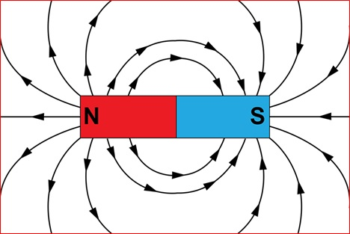
What is a Magnetic Dipole?
A magnetic dipole consists of two opposite magnetic poles separated by a small distance.
It is characterized by a magnetic moment (μ), a vector quantity pointing from south to north.
Common examples include bar magnets and current loops.

Slide 4
Magnetic Dipole Moment (μ)
The magnetic dipole moment quantifies the strength and direction of a dipole's magnetism.
Formula: μ = I × A
Where I = current, A = area vector of the loop.
SI Unit: Ampere· meter square (A·m²)

Slide 5
Interaction with Magnetic Field
When placed in a magnetic field (B), a magnetic dipole experiences a torque.
This torque tends to align the dipole with the field.
It also has an associated potential energy.

Slide 6
Energy of a Magnetic Dipole
The potential energy (U) of a magnetic dipole in a magnetic field is:
U = -μ · B = -|μ||B|cosθ
θ is the angle between μ and B.
Minimum energy when aligned (θ = 0°), maximum when anti-aligned (θ = 180°).

Slide 7
Applications
- Magnetic Resonance Imaging (MRI)
- Magnetic sensors and compasses
- Hard disk data storage
- Electromagnetic theory and quantum mechanics

Slide 8
Conclusion
- Magnetic dipoles are fundamental in physics.
- Their interaction with magnetic fields leads to torque and potential energy.
- Applications span medical imaging, electronics, and fundamental science.

Slide 9
Thankyou!

